Slide 1



What sorcery is this?
How software uses dark patterns to manipulate users
Rachel Appel
rachel@rachelappel.com
http://rachelappel.com

Slide 2
It’s not always just bad design.
Often, it’s deceptive design
Just because you’re paranoid doesn’t mean they’re not out to get you. 👀

Slide 3
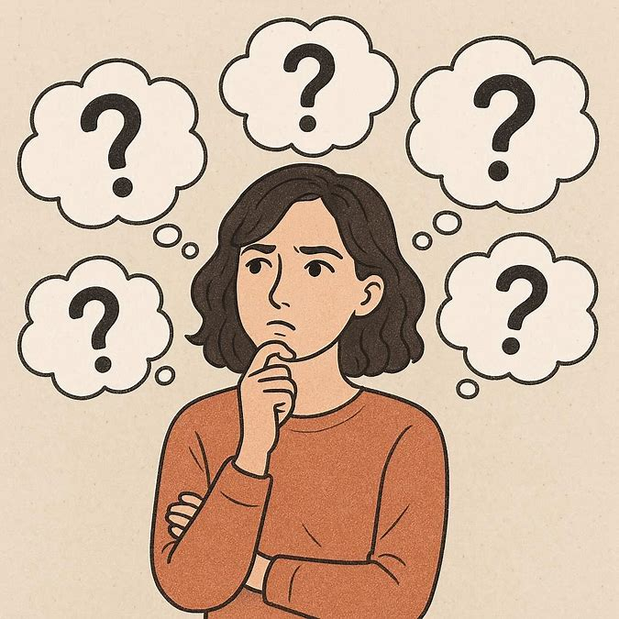
But I’m a developer
Build better products
Protect yourself and family
You’re responsible for your software
Do the right thing
Why should I care about dark patterns?

Slide 4
What are dark patterns?
Notes:
“You can fool all the people some of the time and some of the people all the time, but you cannot fool all the people all the time.” commonly attributed to Lincoln

Slide 5
“Dark patterns are user interface design choices that benefit an online service by coercing, steering, or deceiving users into making decisions that, if fully informed and capable of selecting alternatives, they might not make”.
Dark Patterns at Scale: Findings from a Crawl of 11K Shopping Websites (princeton.edu)
Notes:
Dark Patterns at Scale: Findings from a Crawl of 11K Shopping Websites ARUNESH MATHUR, Princeton University, USA GUNES ACAR, Princeton University, USA MICHAEL J. FRIEDMAN, Princeton University, USA ELENA LUCHERINI, Princeton University, USA JONATHAN MAYER, Princeton University, USA MARSHINI CHETTY, University of Chicago, USA ARVIND NARAYANAN, Princeton University, USA

Slide 6
They’re effective
You can fool all the people some of the time, and some of the people all the time…
Notes:
“You can fool all the people some of the time and some of the people all the time, but you cannot fool all the people all the time.” commonly attributed to Lincoln

Slide 7
Until they’re not.
…but you cannot fool all the people all the time.
https://boagworld.com/talks/encouraging-clicks-without-the-shady-tricks-the-talk/
Notes:
Some people will avoid internet services altogether after being burnt by a dark pattern
There are many overt and hidden costs:
Product returns
Bad word of mouth (40%+ tell about bad experiences)
People will eventually unsub or leave

Slide 8
Dark Patterns can cost you
You know people who have experienced negative effects of dark patterns

Slide 9
“More than eight in 10 Australians (83%) have lost money, lost control of their data or have been manipulated by a business to make a choice that isn't in their interest.”
How website dark patterns can cost you | CHOICE
Notes:
How website dark patterns can cost you | CHOICE

Slide 10
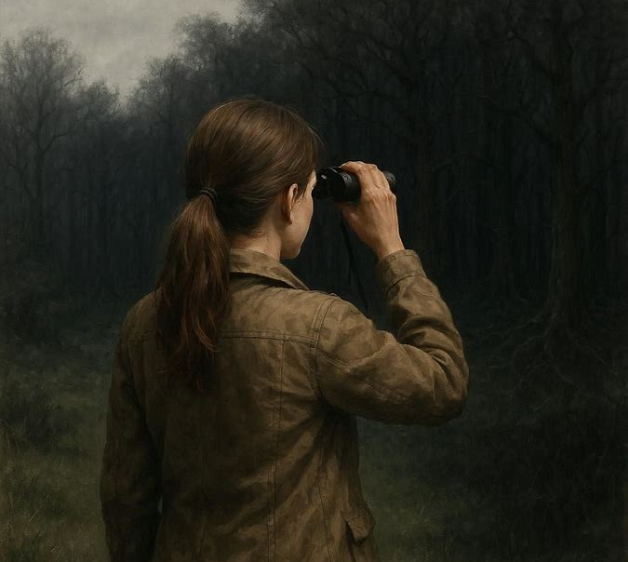

Have you seen them?
Booked a ticket for air travel on a budget airline lately? (Lookin at you, EasyJet).
Have you tried to cancel Amazon Prime?
Good luck with that.
Dark patterns are prevalent.
Notes:
https://www.thefarmersdog.com (Try to view prices)
easyJet | Cheap flights ✈︎ Book low-cost flight tickets

Slide 11
Tactics of Dark Patterns
Trick questions & UI elements
Sneak into basket
Privacy suckering
Price comparison prevention
Misdirection of attention
Hidden costs
Bait and switch
Psychological tricks
Notes:
Privacy suckering is being tricked into oversharing info
Hidden cost
Disguised advertisment
Trick question
Scarcity cue
Activity notification
Confirmshaming
Forced continuity
False hierarchy
Redirection or nagging
Data-grab

Slide 12
That one weird trick to spotting dark patterns.
Clickbait titles are a mature and well-known dark pattern

Slide 13
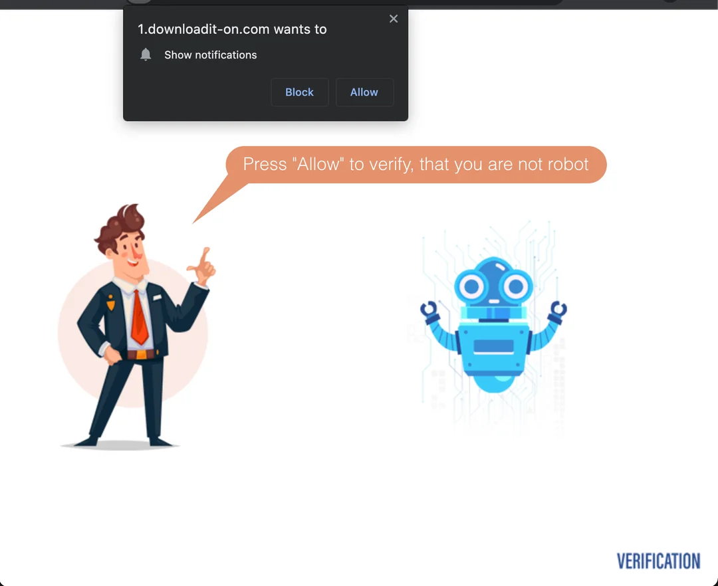

Slide 14
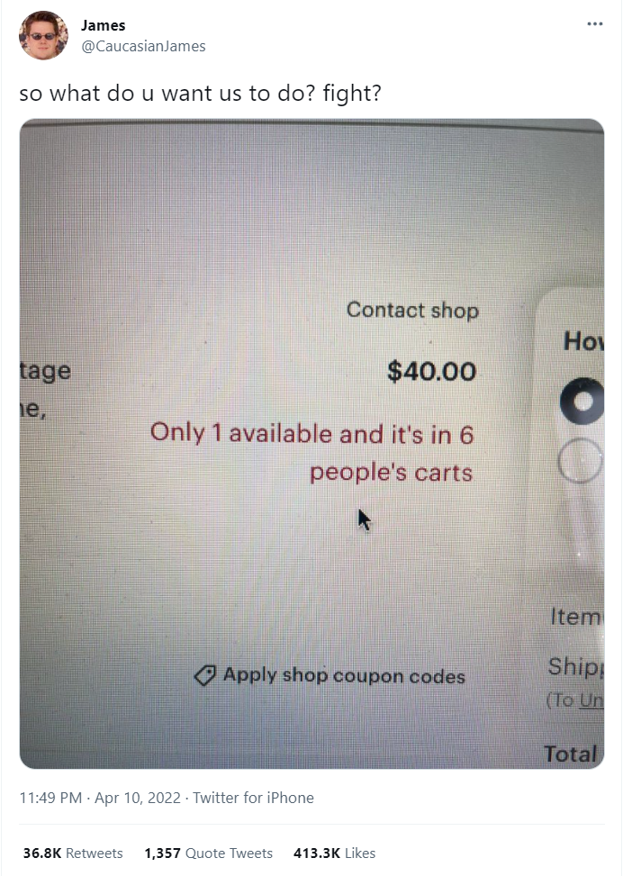
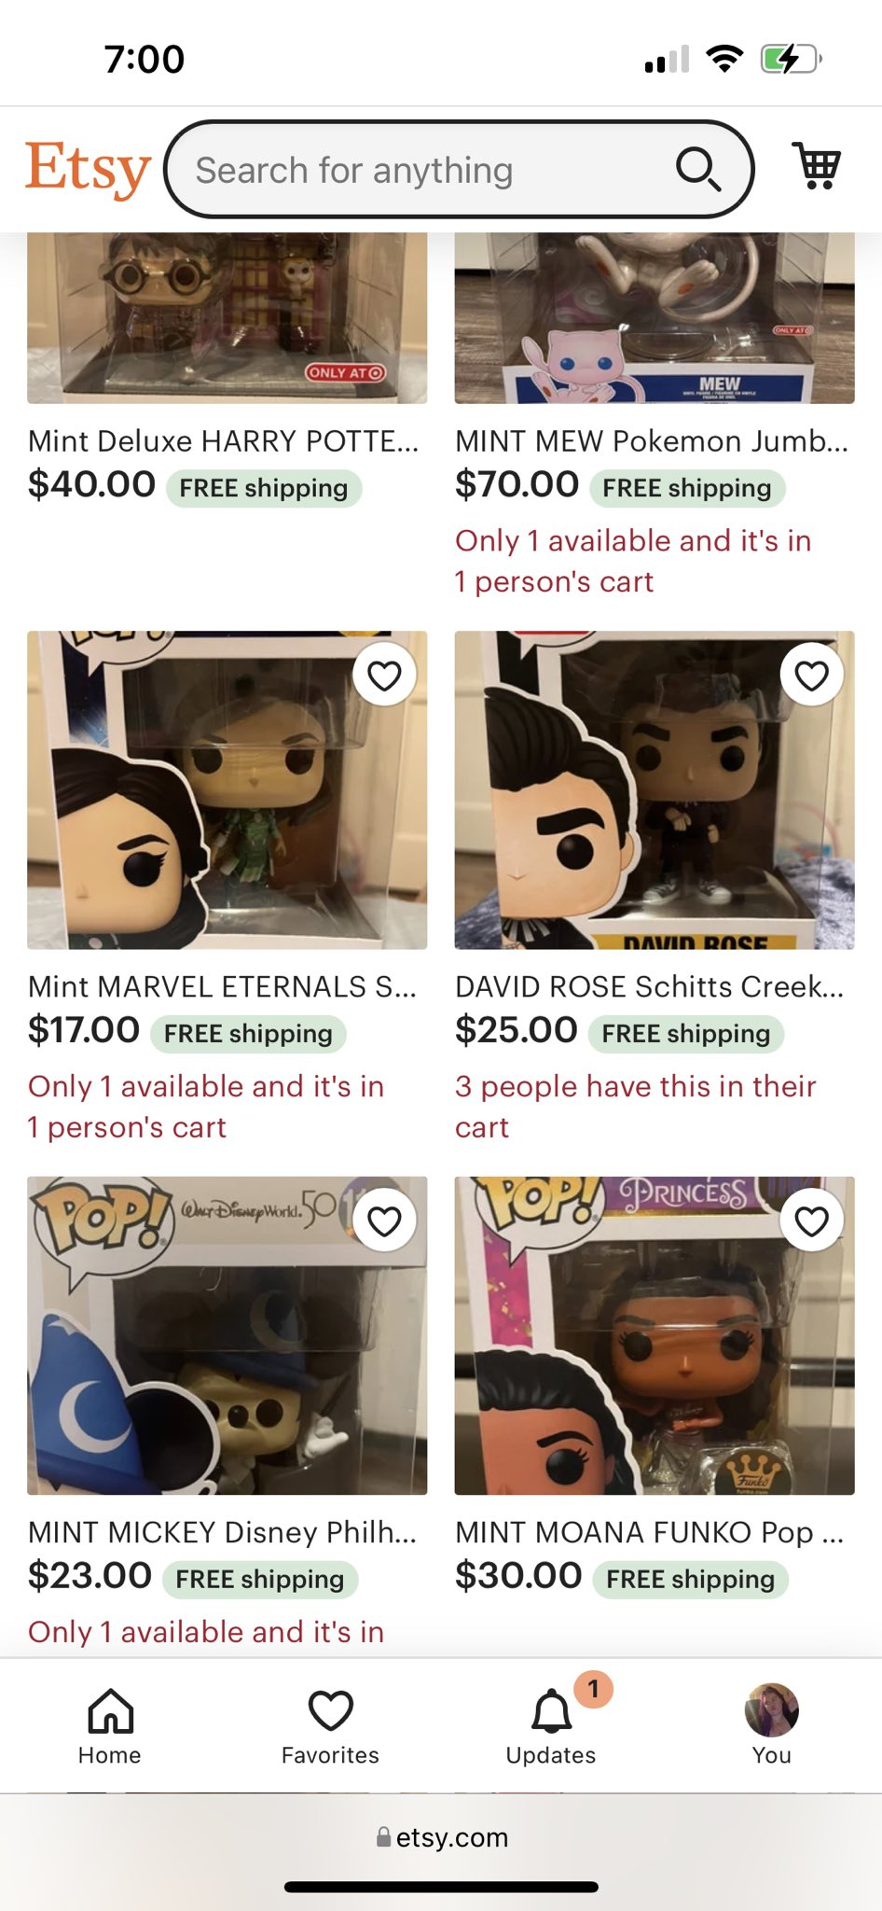
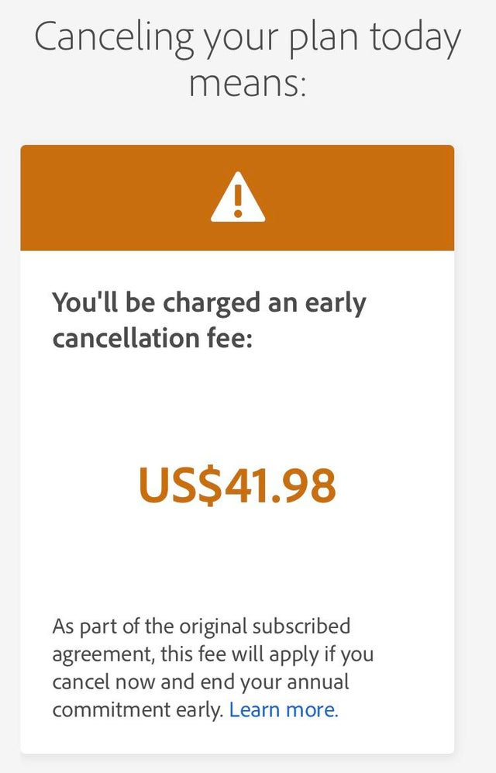
Notes:
James on Twitter: "so what do u want us to do? fight? https://t.co/ot2Grpmi0N" / Twitter

Slide 15
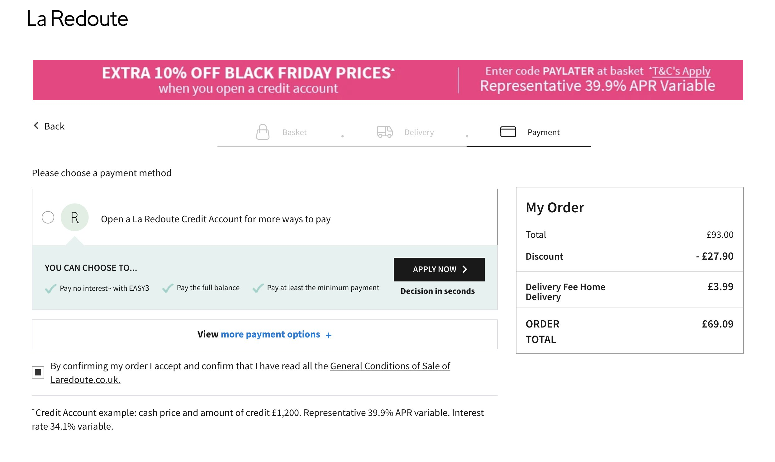
La Redoute pushes you to get credit

Slide 16
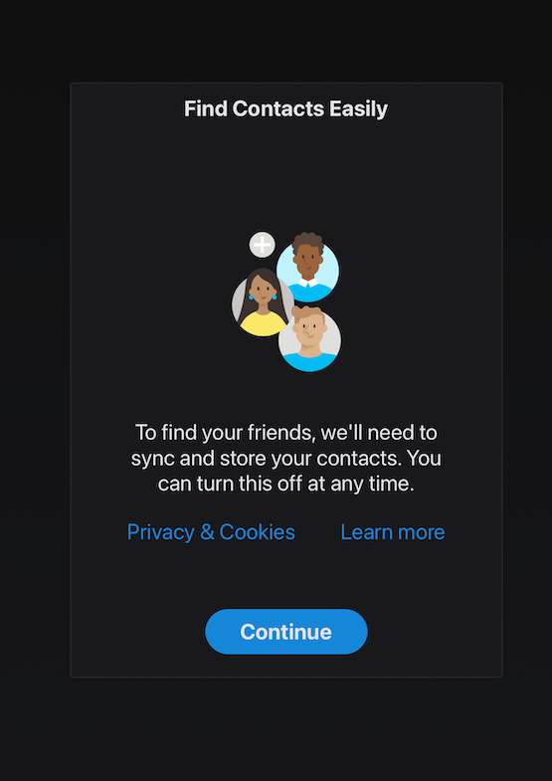
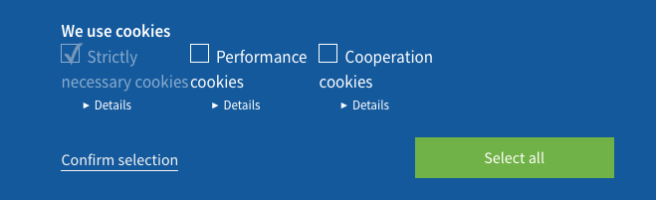
Sedo.com
There is no way to say NO
Notes:
briankrebs on Twitter: "Noticed my Skype client on the iPad started doing this sneaky crap where when you open the app it presents a prompt that asks you to approve sharing all your contacts w/ Skype. And there's no visible way to say "no." https://t.co/Zw4hPKt4Gx" / Twitter

Slide 17
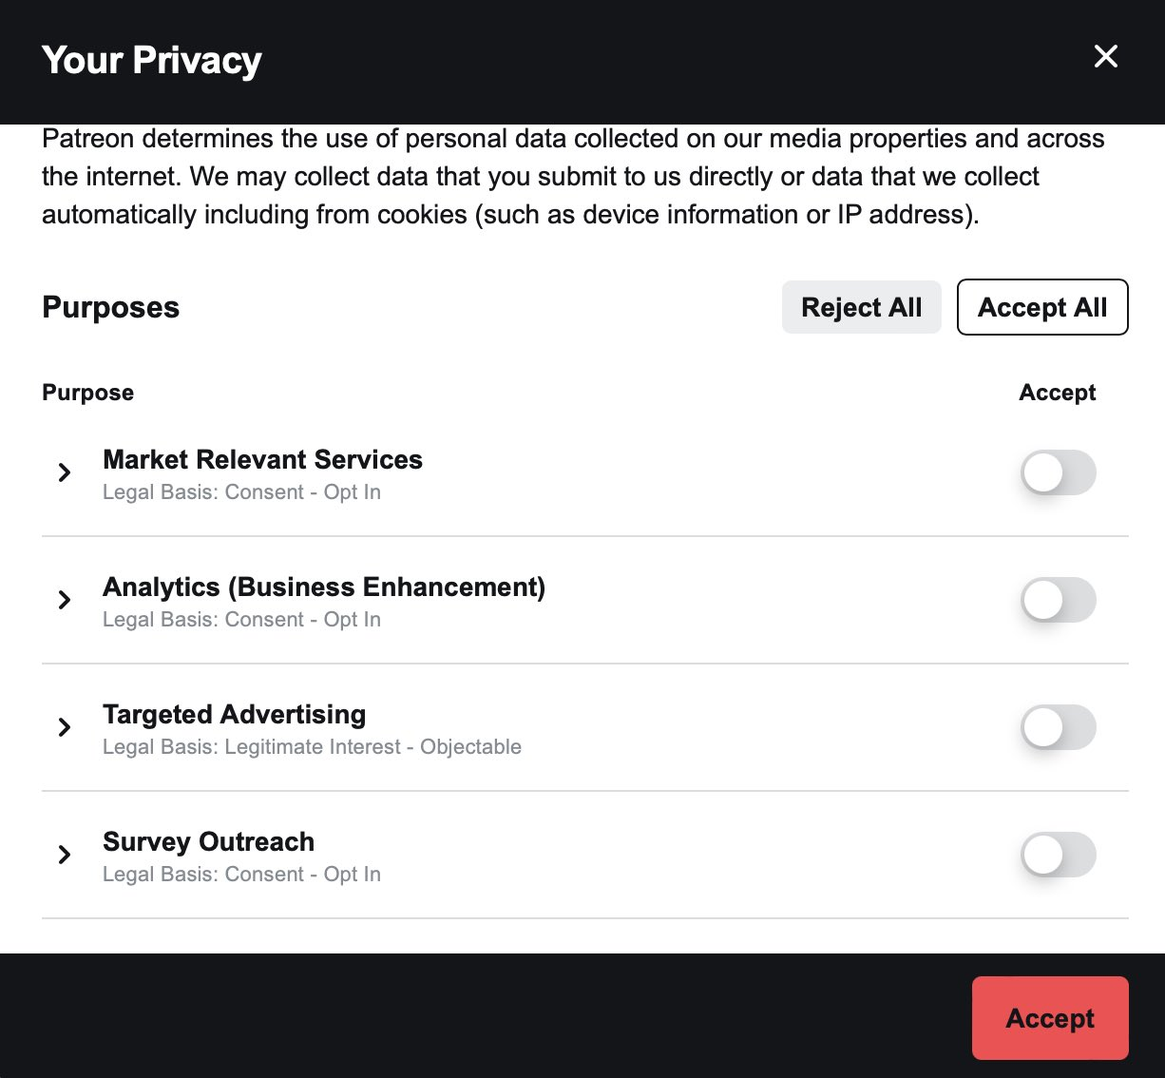

Slide 18
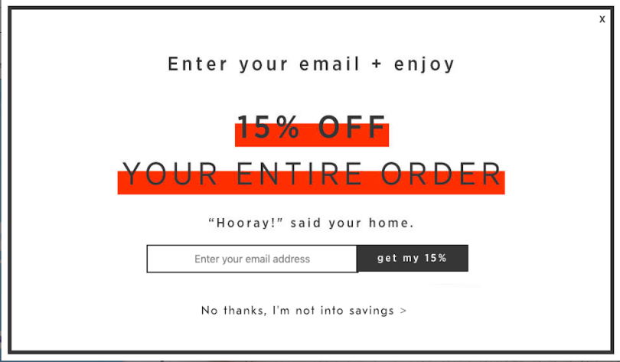
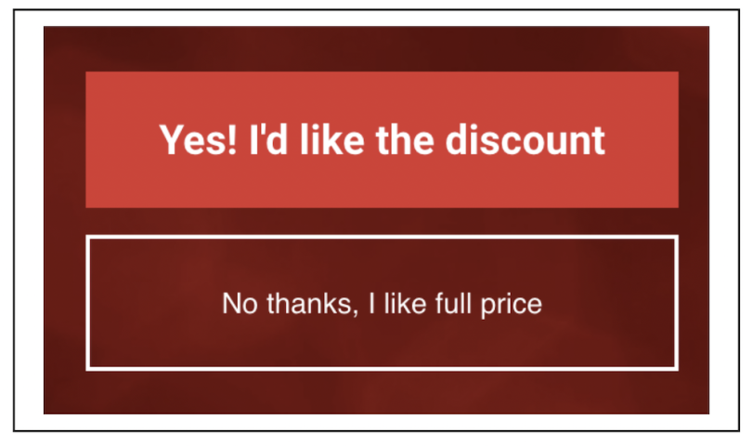
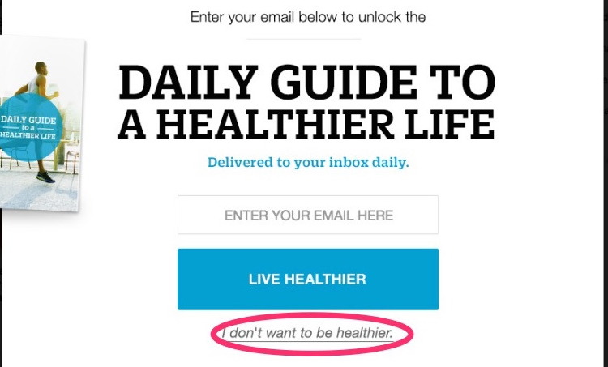


Slide 19
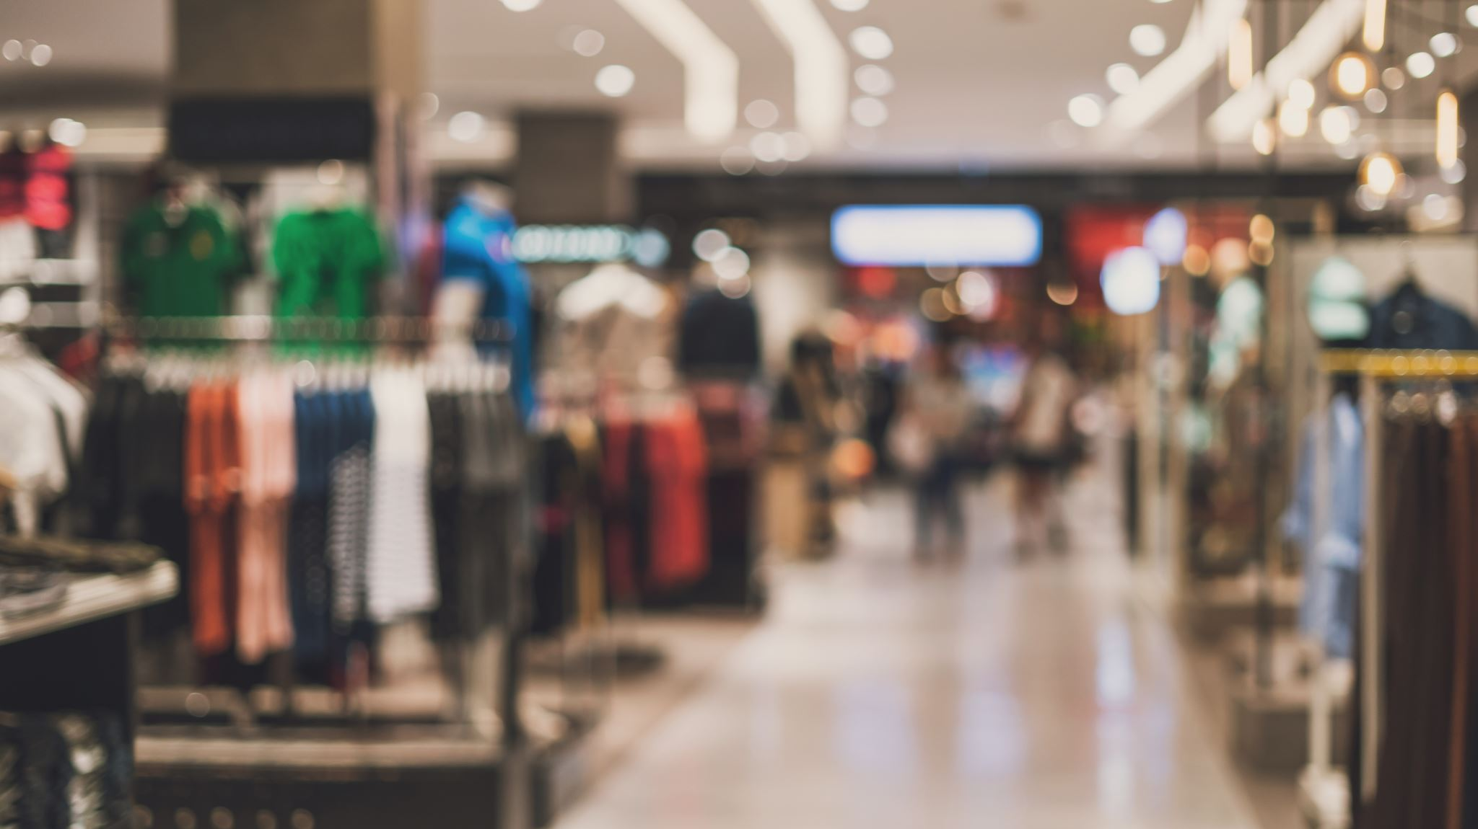
In the physical world
Gruen Transfer Effect
Online: Booking.com and similar sites
Notes:
“In shopping mall design, the Gruen transfer is the moment when consumers enter a shopping mall or store and surrounded by an intentionally confusing layout, lose track of their original intentions, making them more susceptible to making impulse buys”. (src: Wiki)

Slide 20
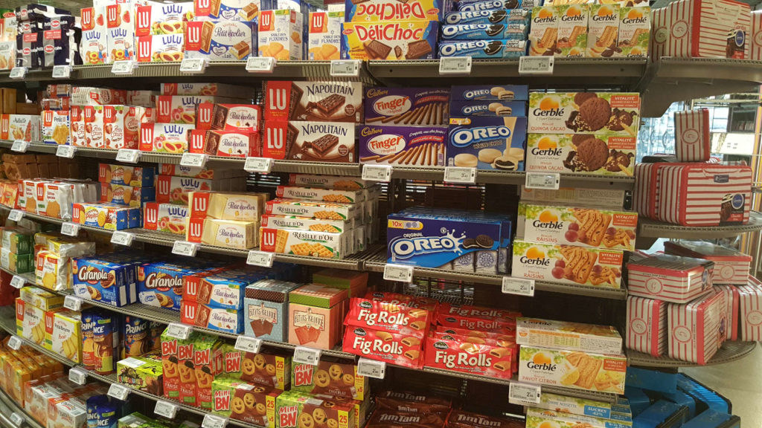
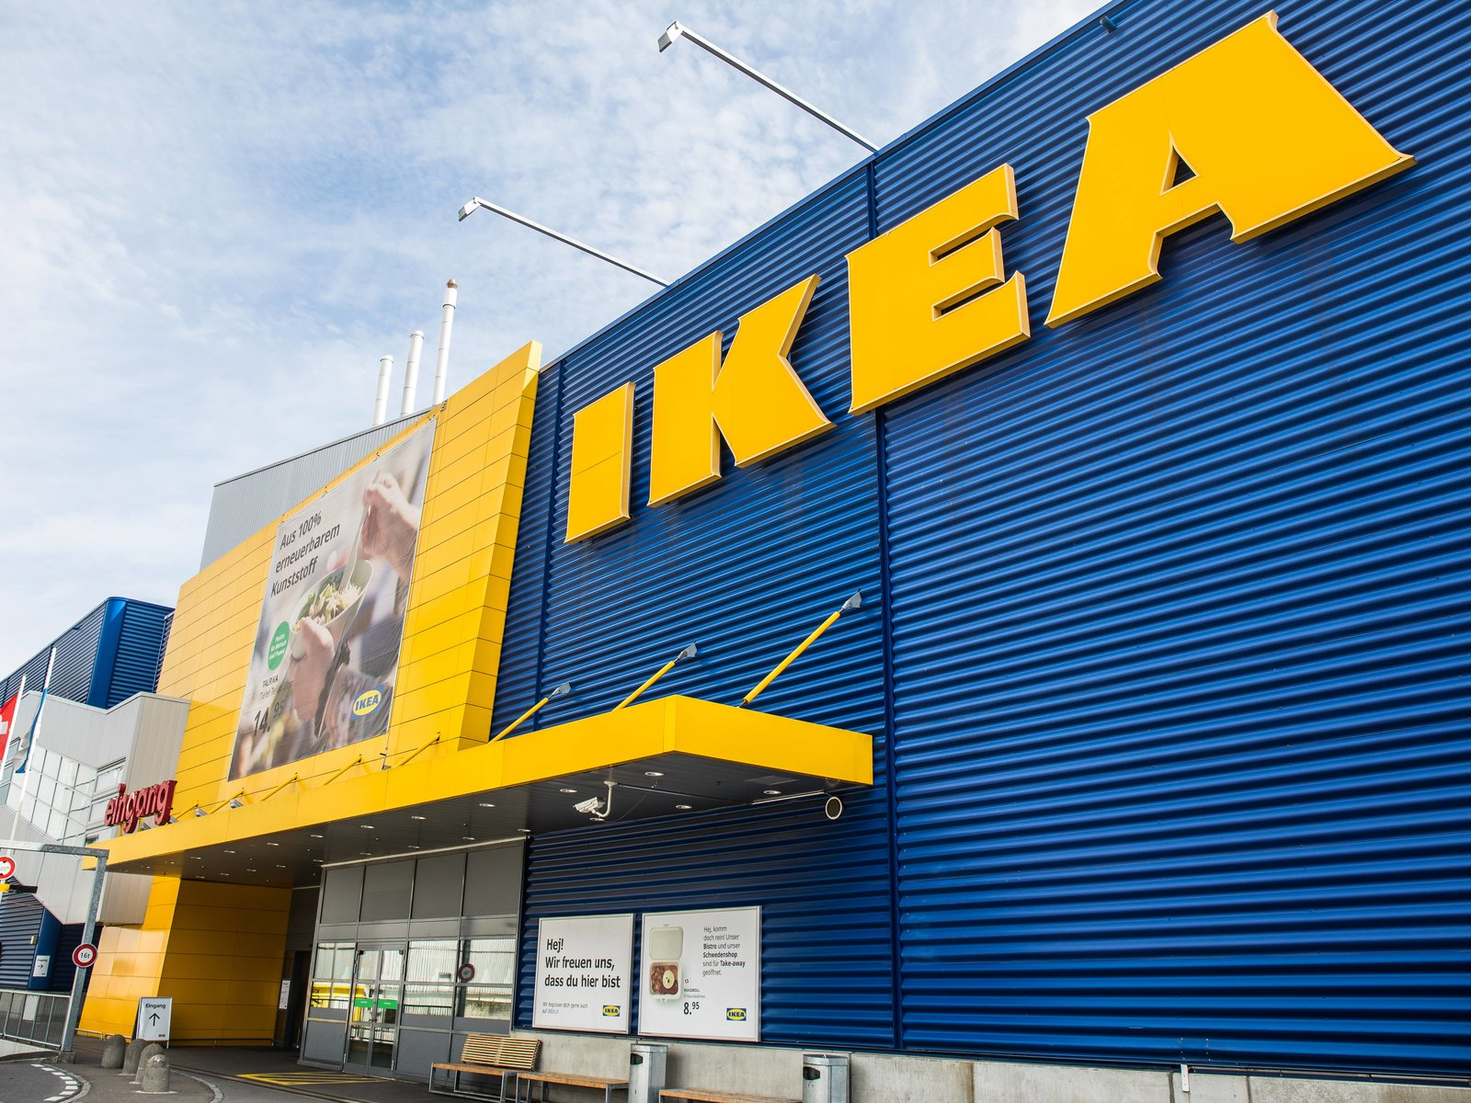


Slide 21
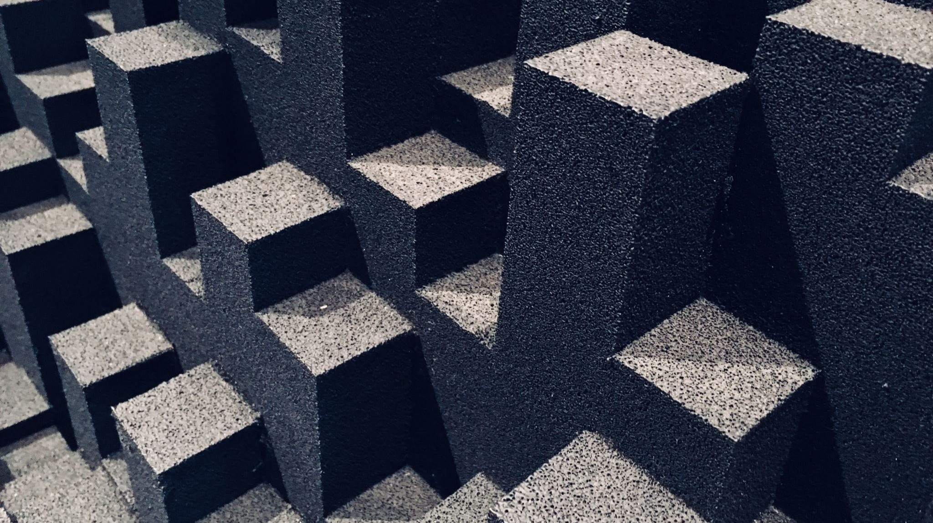
Choice Architecture
Gray-dark patterns

Slide 22
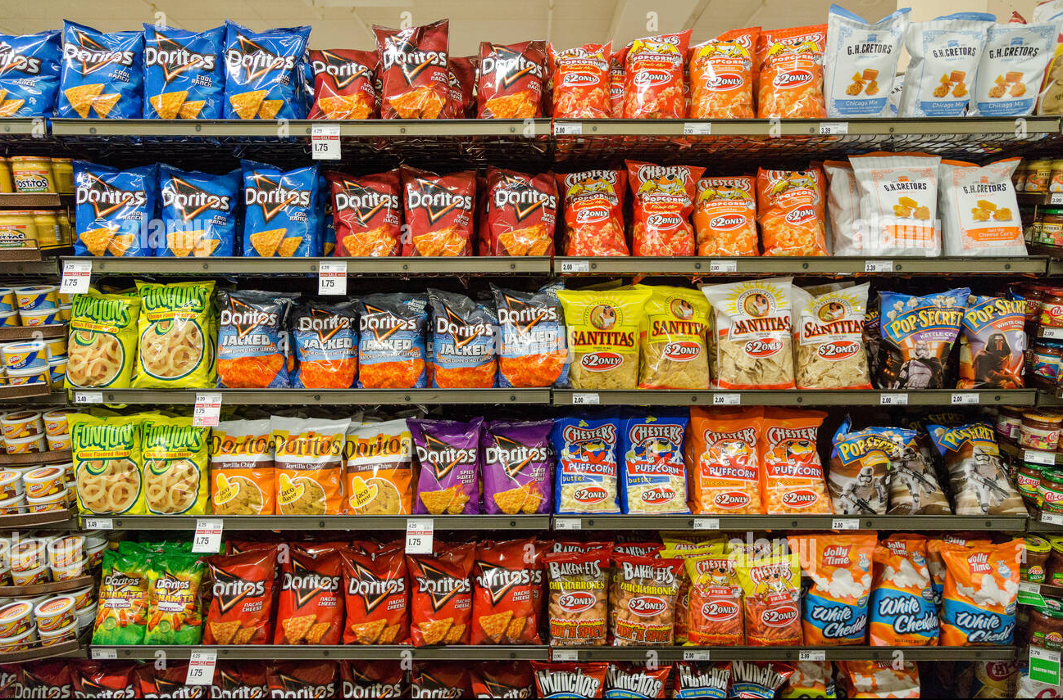
Grocery store choice architecture
Impulse items near cashiers
Misleading/confusing labels
Increased cart size
Eye-level items cost more
Essentials in back, so you walk through non-essentials
Sensory plays (flowers, baked goods in front)
99 cent pricing

Slide 23
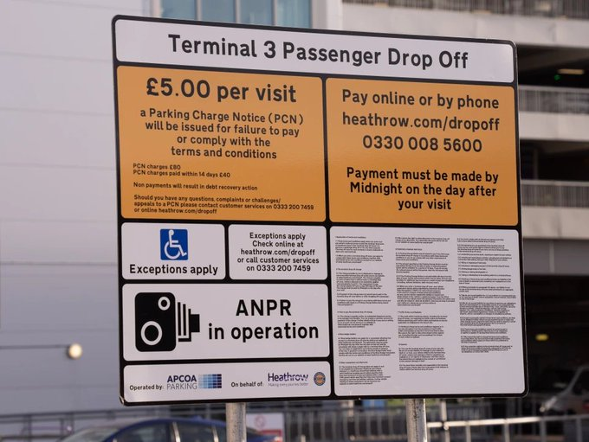
Pay online later. But you’ll probably forget.

Slide 24
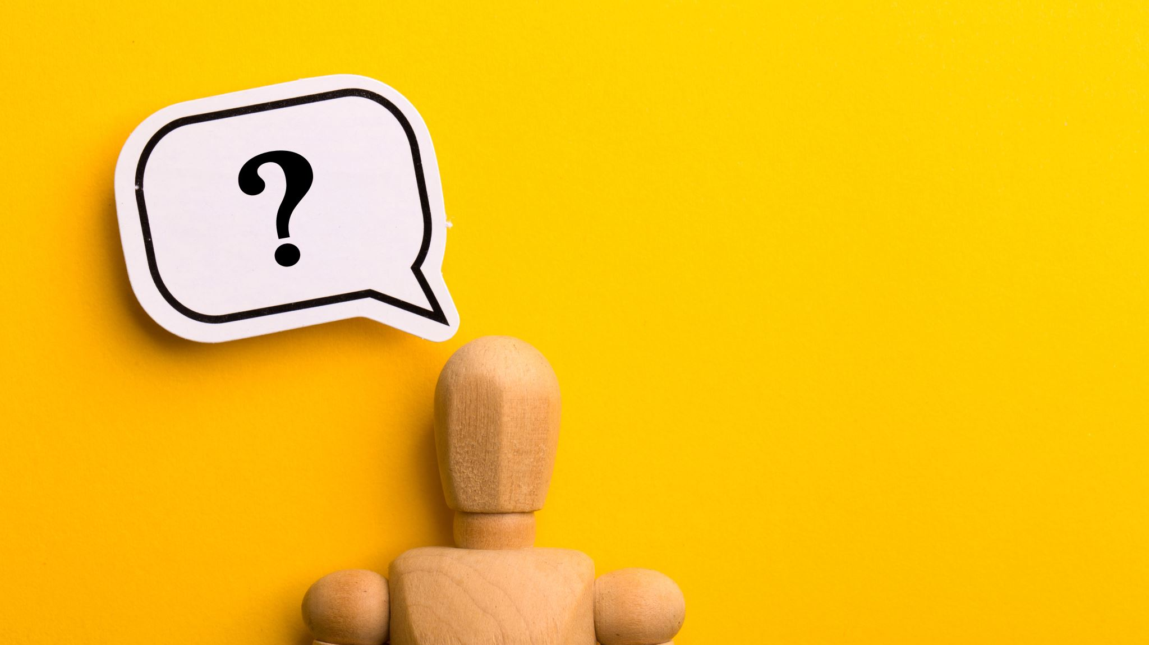
Why does this happen?
What’s going on here?

Slide 25

The psychology behind dark patterns
There are psychological principles behind manipulative patterns.

Slide 26
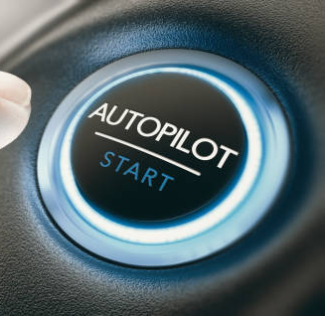
Heuristics
Often, heuristics are
beneficial patterns
Sometimes, heuristics are
anti-patterns
You can hijack heuristics with dark patterns
Notes:
“Heuristics are mental shortcuts that can facilitate problem-solving and probability judgments. These strategies are generalizations, or rules-of-thumb, reduce cognitive load, and can be effective for making immediate judgments, however, they often result in irrational or inaccurate conclusions”. –The decision lab
The science of decision making - Often called “Choice Architecture”
Millions of decisions https://www.britannica.com/science/information-theory/Physiology
Subconscious https://media.imaxws.com/912/howcustomersthink.pdf

Slide 27
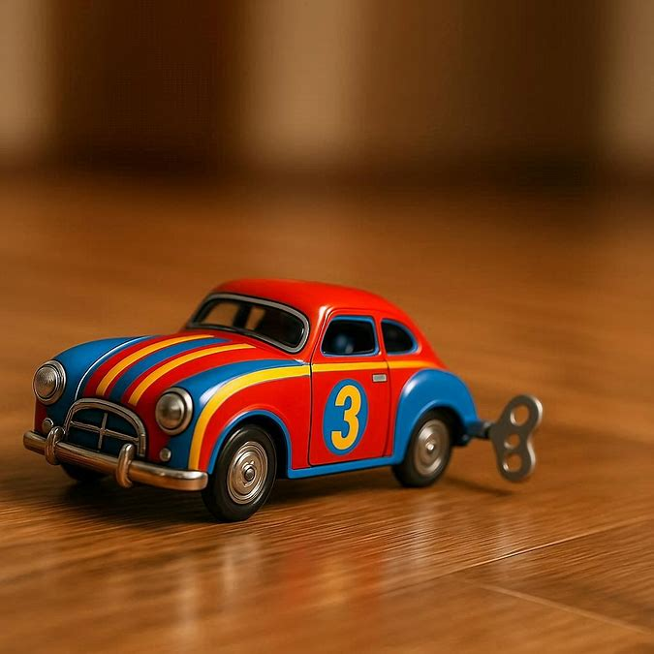
Robert Cialdini’s
“click, whirr!” effect
A tactic of media pundits and con people
Drives social media algorithms
Notes:
- Confirmshaming is a good example

Slide 28
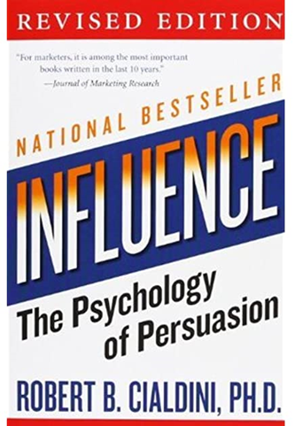
Cialdini’s Principles of Persuasion
Social proof
Reciprocity
Authority
Liking
Commitment/Consistency
Scarcity
Unity

Slide 29
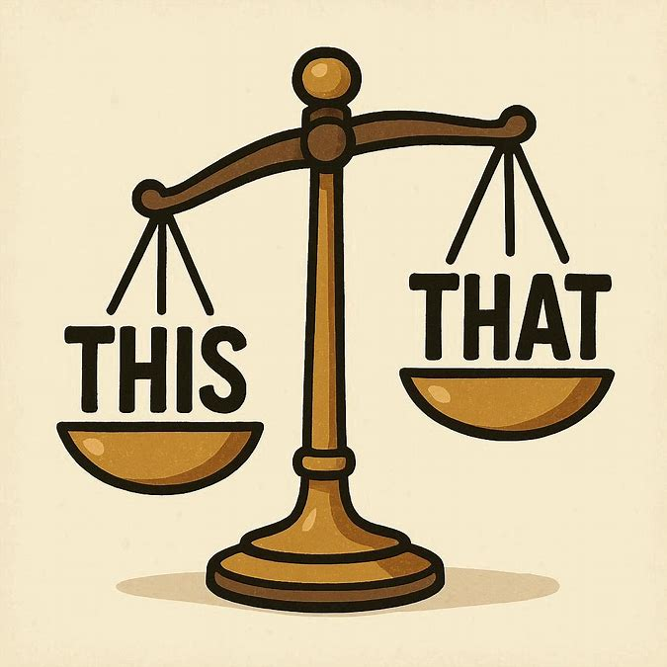
Biases

Slide 30
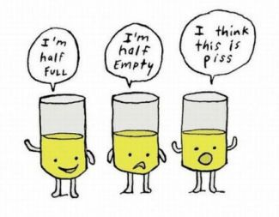
Framing effect
Notes:
The framing effect is when our decisions are influenced by the way information is presented. Equivalent information can be more or less attractive depending on what features are highlighted.

Slide 31
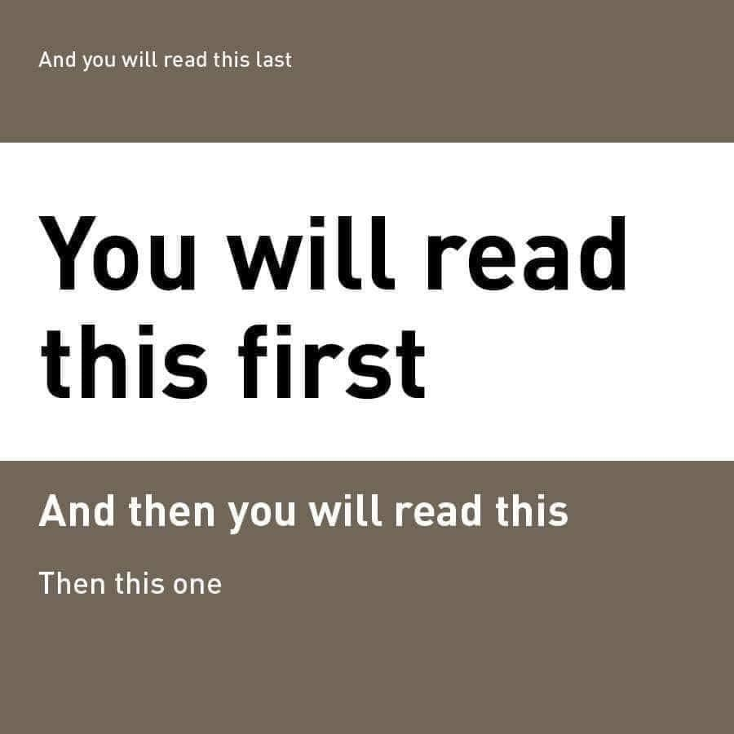

Slide 32
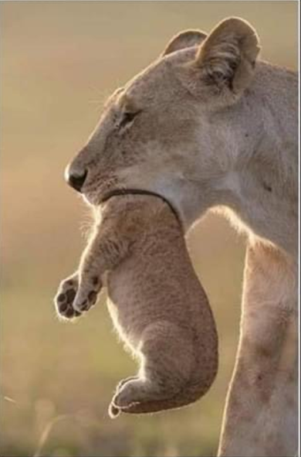


Slide 33
Which do you prefer?
85% lean beef
90% chance of surviving an operation
$120 Off (Price, $600)
We’re the 5th best team! (5 of 5)
Can I help you?
15% fatty beef
10% chance of dying during the operation
20% Off (Price, $600)
We are the worst team! (5 of 5)
How can I help you?

Slide 34

Anchor effect
The common human tendency to rely too heavily on the first piece of information offered
Job negotiations
MSRP stickers
Pricing
Search results*
Reviews*
*These are also partly the primacy effect
Notes:
What is Amazon's Choice? Amazon's Choice makes it easy to discover products that other customers frequently choose for similar shopping needs.
From Amazon FAQs

Slide 35
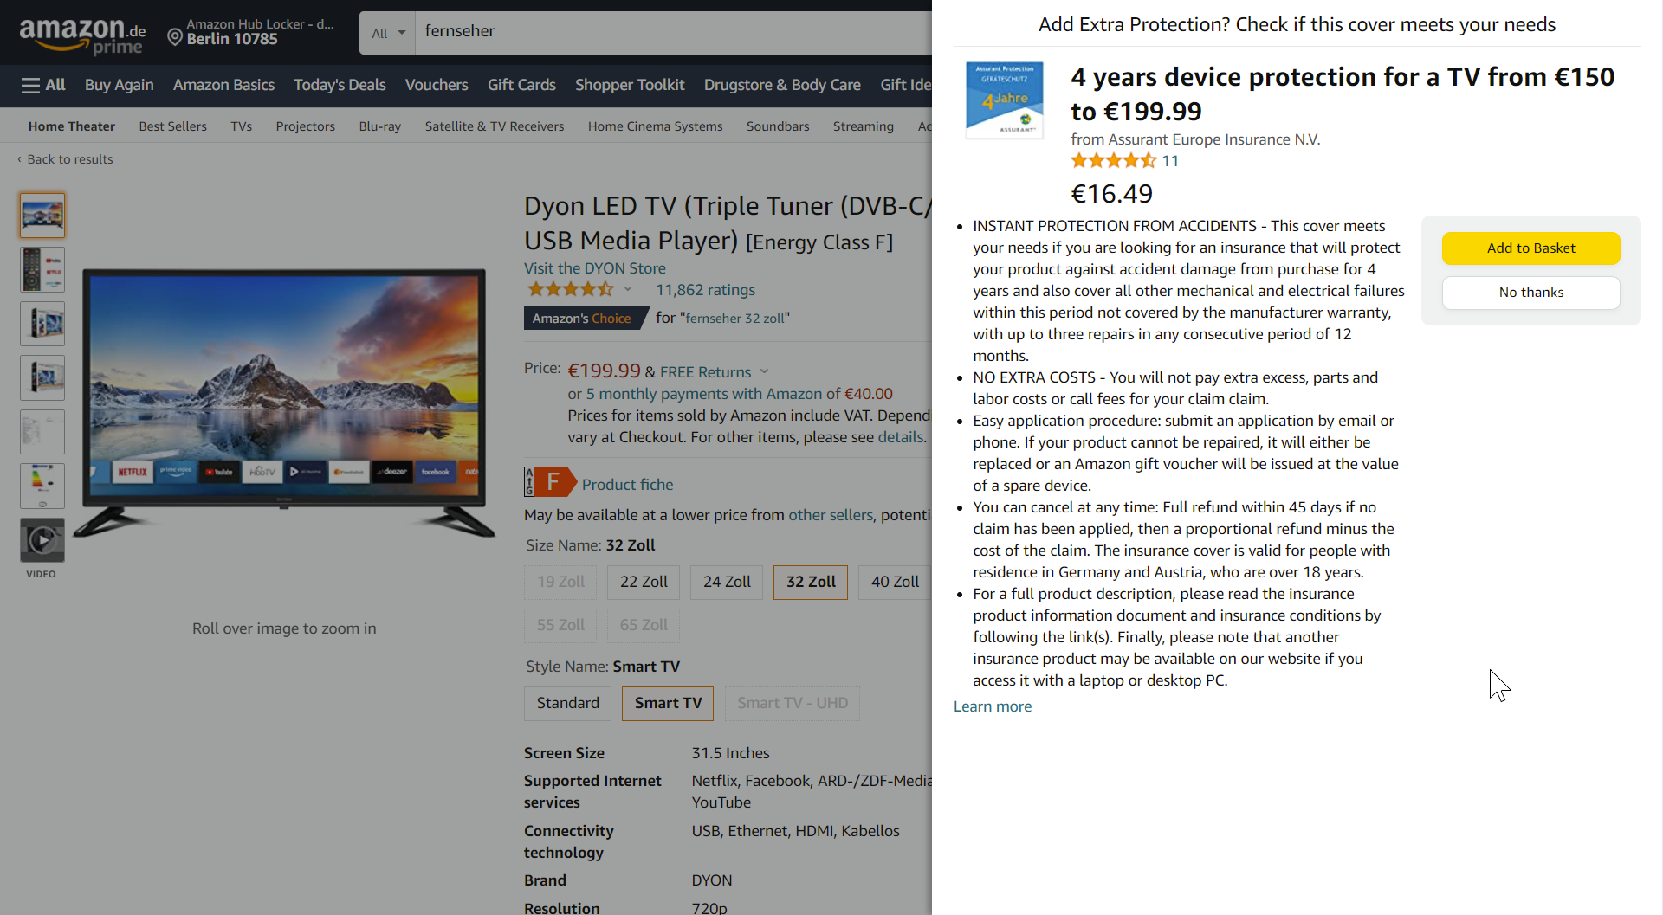
Online Shopping Cart Choice Architecture

Slide 36
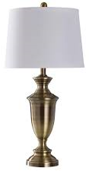
People conflate time with space and distance
Furnish your home in style with West’s Furniture
Furnish your home in style with West’s Furniture
This lamp was seen as antique
This lamp was seen as modern

Slide 37
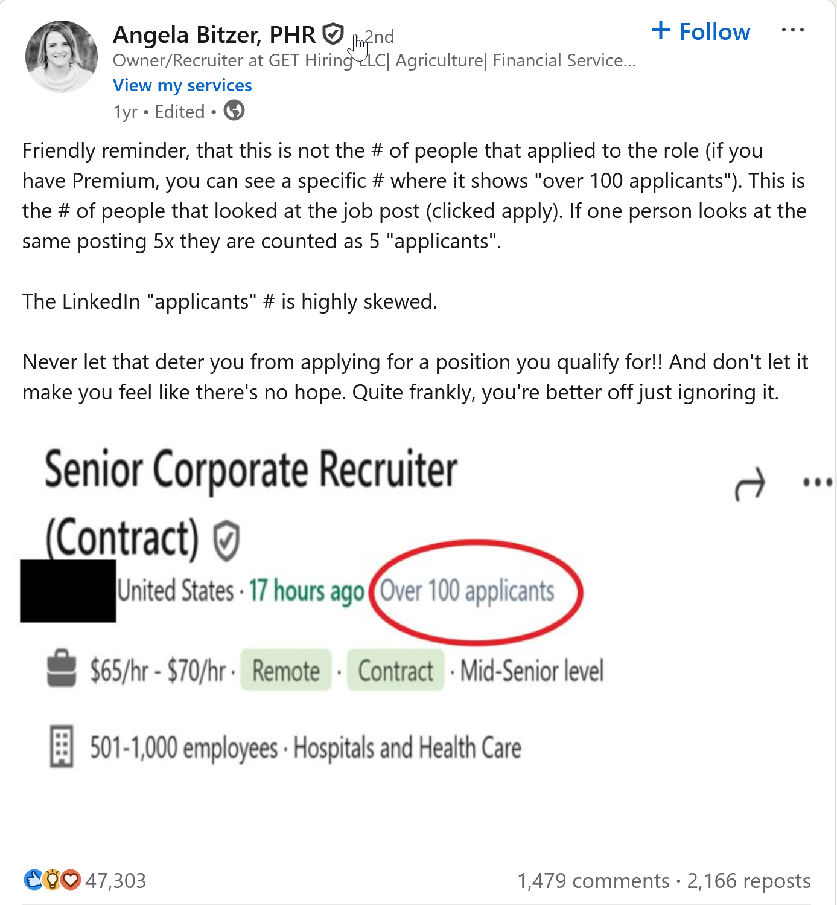


Notes:
https://www.linkedin.com/posts/angelabitzer_friendly-reminder-that-this-is-not-the-activity-7194001254753132546-W7-n

Slide 38

Mere-exposure effect
Lie enough times
and people will think it’s true
Show your product enough times
and people will think they need it
Notes:
Remember old school commercials repeated ad-nauseum? Mere exposure.
Combine with jingles and other catchy phrases or tunes and it’s a winning combo for the advertiser.

Slide 39
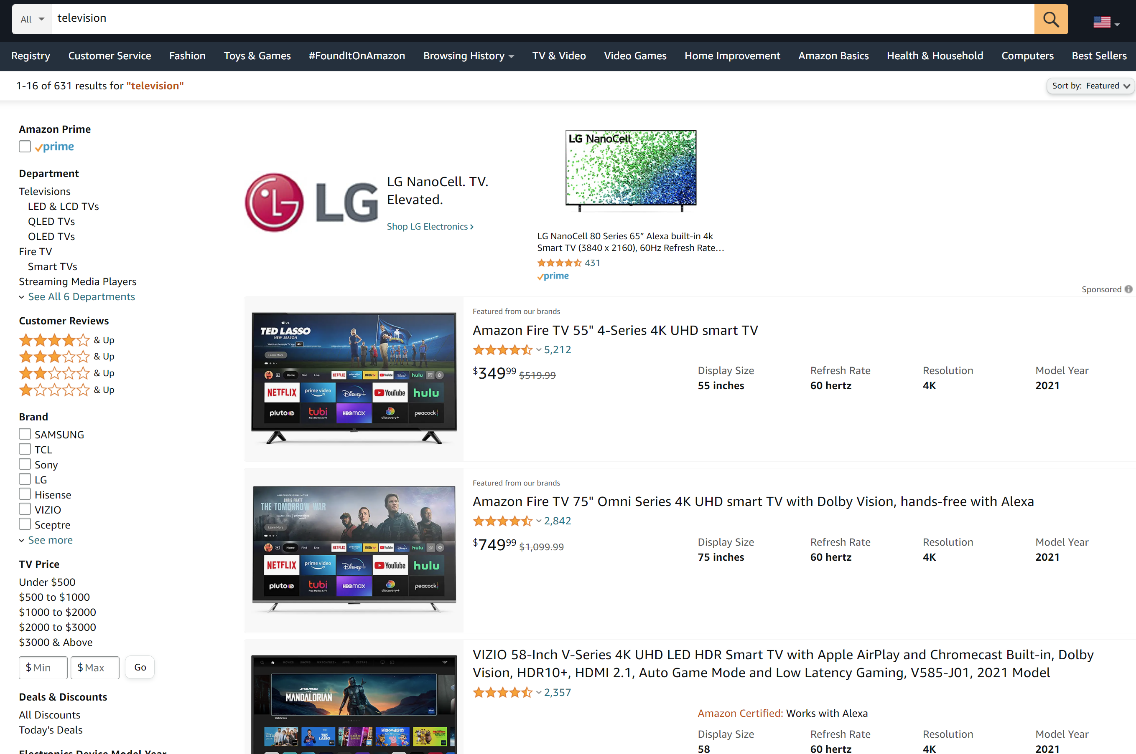
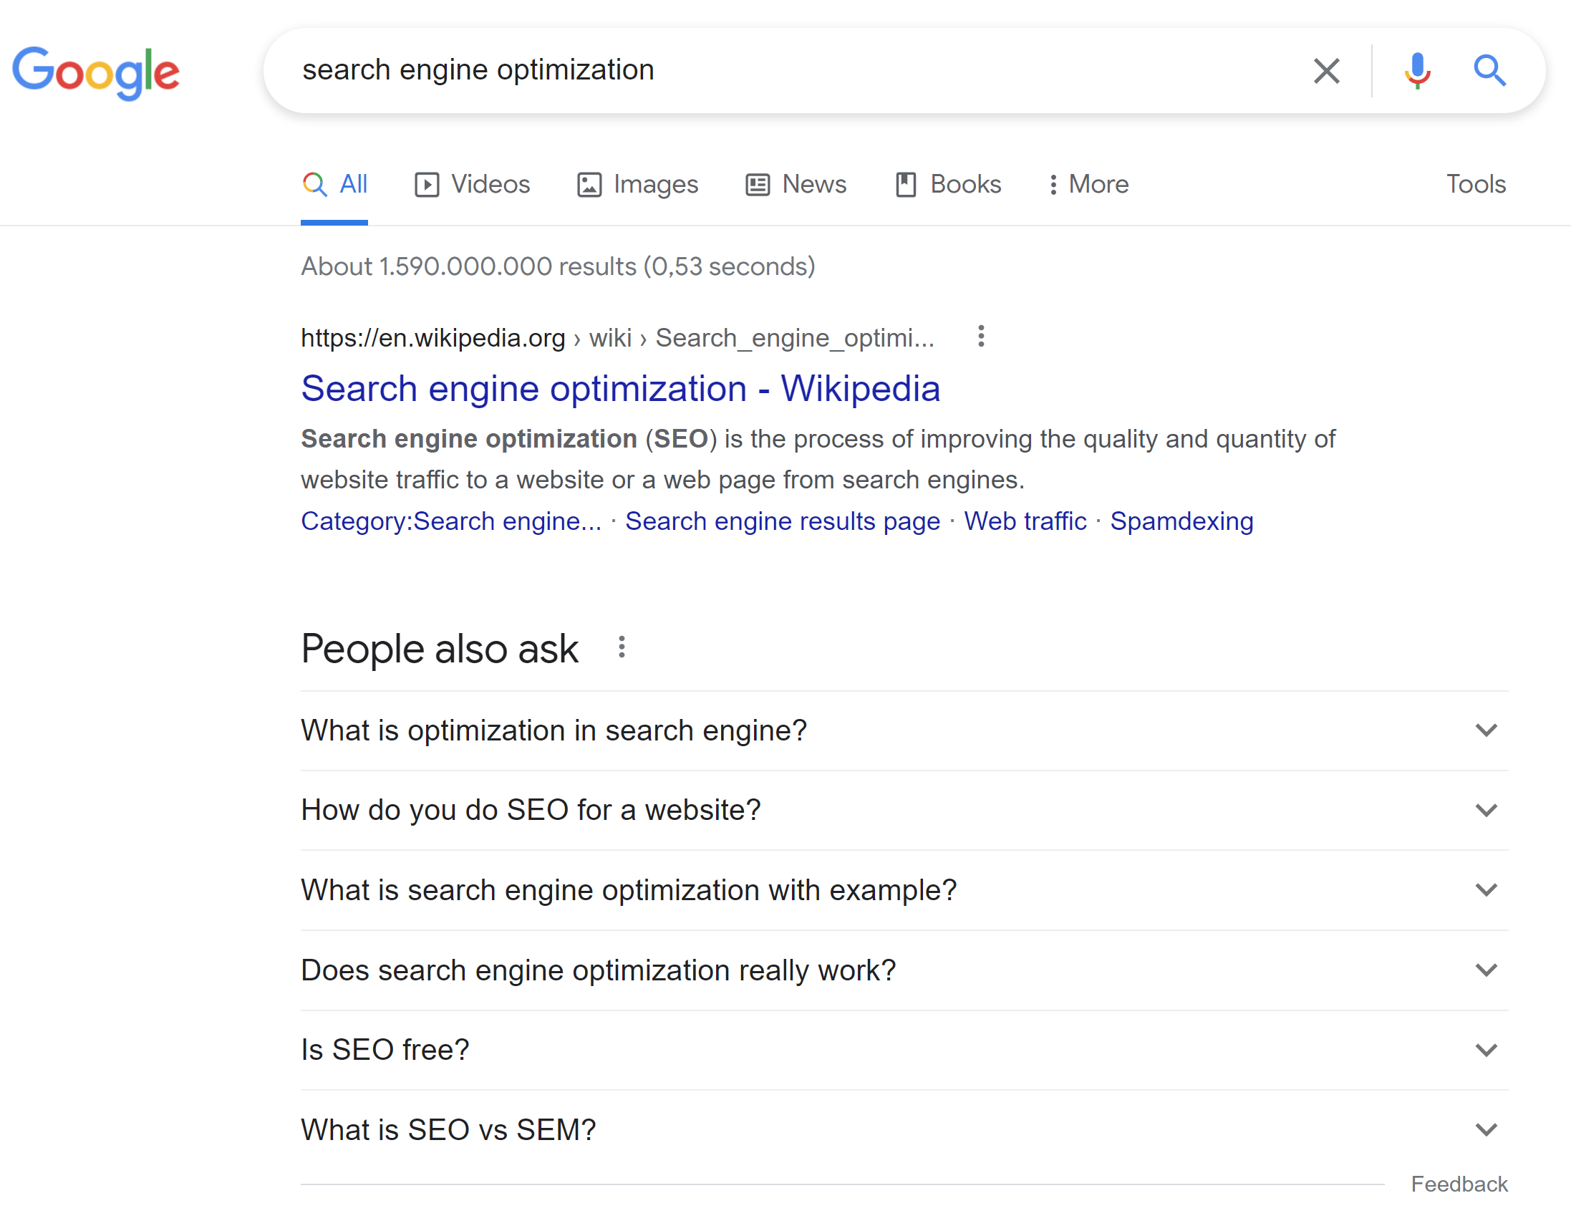
Be the first in the list | Primacy effect

Slide 40
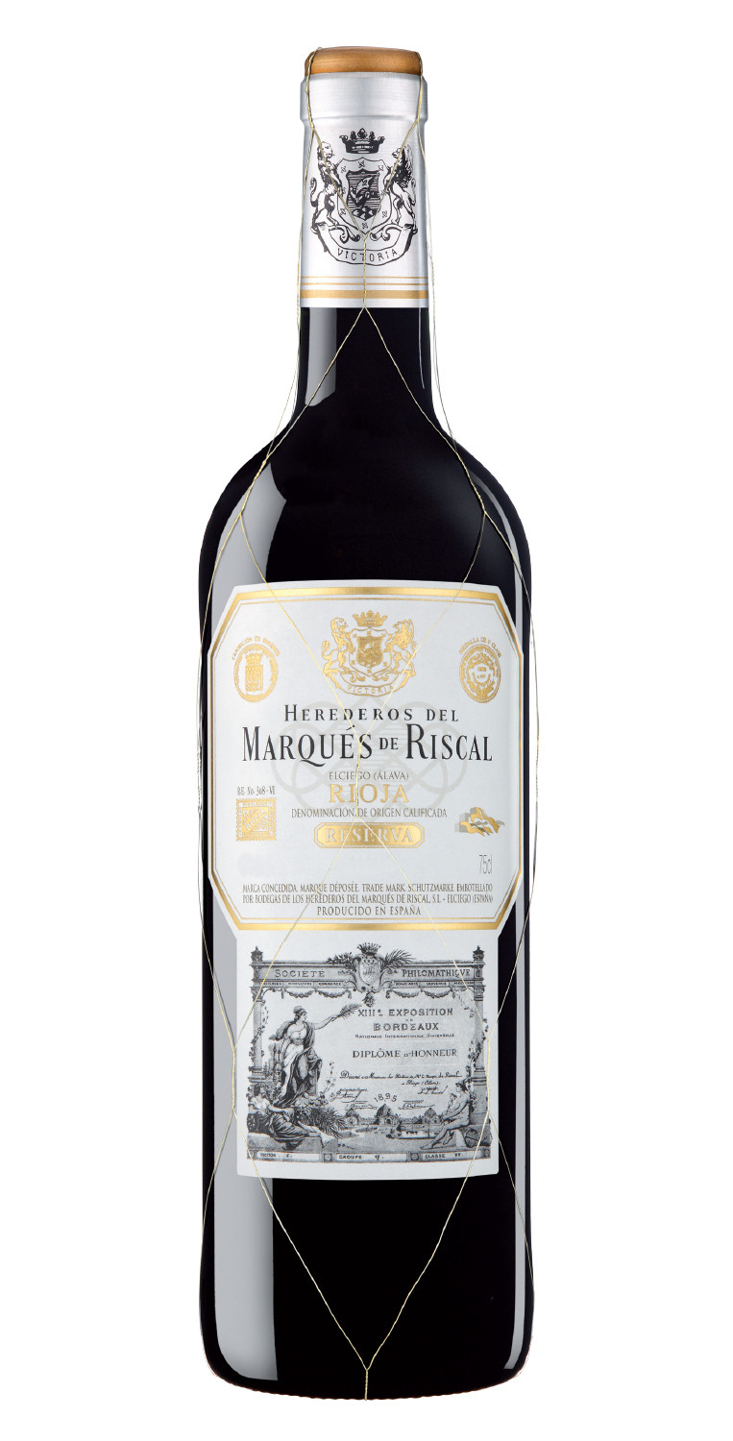
Physical size of fonts and prices
Marqués de Riscal Reserva
Marqués de Riscal Reserva
This excellent award-winning wine comes from the Rioja region of Spain. 2016 was a great year for wines, and this wine is our best!
This excellent award-winning wine comes from the Rioja region of Spain. 2016 was a great year for wines, and this wine is our best!
$29.99
$29.99
We conflate font sizes and physical sizes with numerical cost
Notes:
We also conflate physical size with numerical size. If a price is written in a smaller font, we actually think it’s a lower price than if it’s written in a larger font
JCP1501.vp (uconn.edu)

Slide 41
Now it’s on sale!
Marqués de Riscal Reserva
Marqués de Riscal Reserva
This excellent award-winning wine comes from the Rioja region of Spain. 2016 was a great year for wines, and this wine is our best!
This excellent award-winning wine comes from the Rioja region of Spain. 2016 was a great year for wines, and this wine is our best!
$24.99
Was $29.99
$24.99
Was $29.99
Moving the previous, more expensive price further away makes it FEEL like there’s a wider gap in price.
Notes:
We also conflate physical size with numerical size. If a price is written in a smaller font, we actually think it’s a lower price than if it’s written in a larger font
JCP1501.vp (uconn.edu)

Slide 42
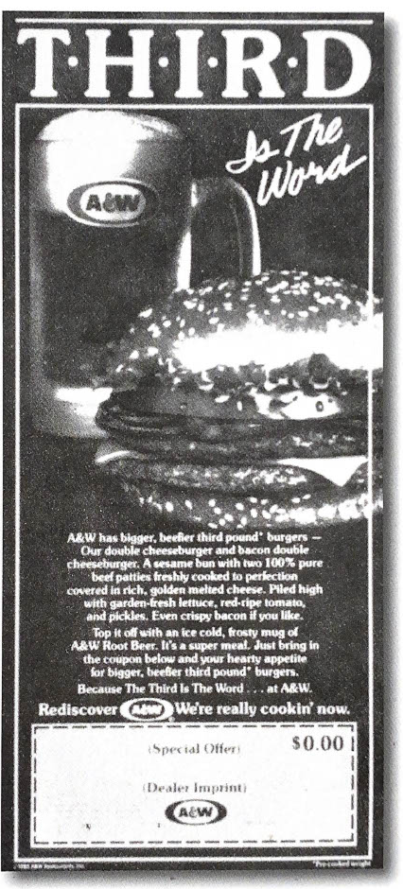
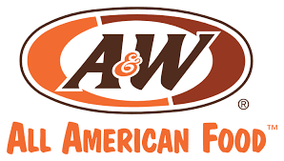
“You ain’t fooling me with that, A&W!”
“Everyone knows 1/4 is bigger than 1/3”
When polled, over half of the respondents said they thought the ¼ pounder was bigger.
🤦‍♀️

Slide 43

The Shape Of Your Glass Influences Alcohol Consumption
Notes:
The effect of glass shape on alcohol consumption in a naturalistic setting: a feasibility study
In the first session, the study participants were given glasses of either a beer or a non-alcoholic soft drink, served from either a straight-sided glass or a “fluted” glass with a curvy taper to a narrow base. Those drinking beer from the curved glass finished their drinks nearly twice as fast as the participants drinking the alcohol from the straight-sided glass. There was, however, no difference in soft drink consumption rates.
Search
Search
Home / How The Shape Of Your Glass Influences Alcohol Consumption
How The Shape Of Your Glass Influences Alcohol Consumption
By Jena Hilliard | May 16, 2019 | 4 Sources
Categories:
binge drinking
Lifestyle
Tips
Get help today (844) 596-1243
- OR -Get a Call
Can The Shape Of Your Glass Affect Your Drinking Habits?
In the United States, binge drinking is the most common and dangerous pattern of excessive alcohol use. Binge drinking is defined as the consumption of an excessive amount of alcohol in a short period of time that brings an individual’s blood alcohol concentration (BAC) to 0.08 or more. The speed at which we consume alcohol depends on a variety of factors. However, according to new research from the University of Bristol, a major contributing factor behind how quickly we down an alcoholic beverage may be because of the shape of the glass that we’re holding.
Two studies presented by Bristol’s Tobacco and Alcohol Research Group at the 2015 British Psychological Society Annual Conference demonstrated just how influencing the shape and size of a glass can be on drinking habits. To test the theory of whether there’s actually a correlation between the two, Dr. Angela Attwood from the University of Bristol recruited a total of 160 men and women, aged 18-40 with no history of alcohol problems, to attend two experimental sessions.
Curvy vs. Straight Glasses
In the first session, the study participants were given glasses of either a beer or a non-alcoholic soft drink, served from either a straight-sided glass or a “fluted” glass with a curvy taper to a narrow base. Those drinking beer from the curved glass finished their drinks nearly twice as fast as the participants drinking the alcohol from the straight-sided glass. There was, however, no difference in soft drink consumption rates.
In the second test, the participants were asked to look at images of the two types of glasses with varying volumes of liquid and asked whether they thought they were more or less than half full. The results showed that there was a greater degree of error when it came to judging levels in the curved glasses.

Slide 44
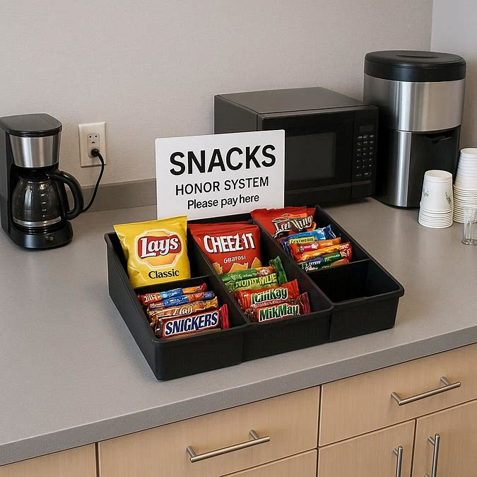
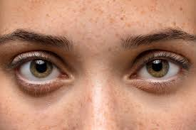

Slide 45
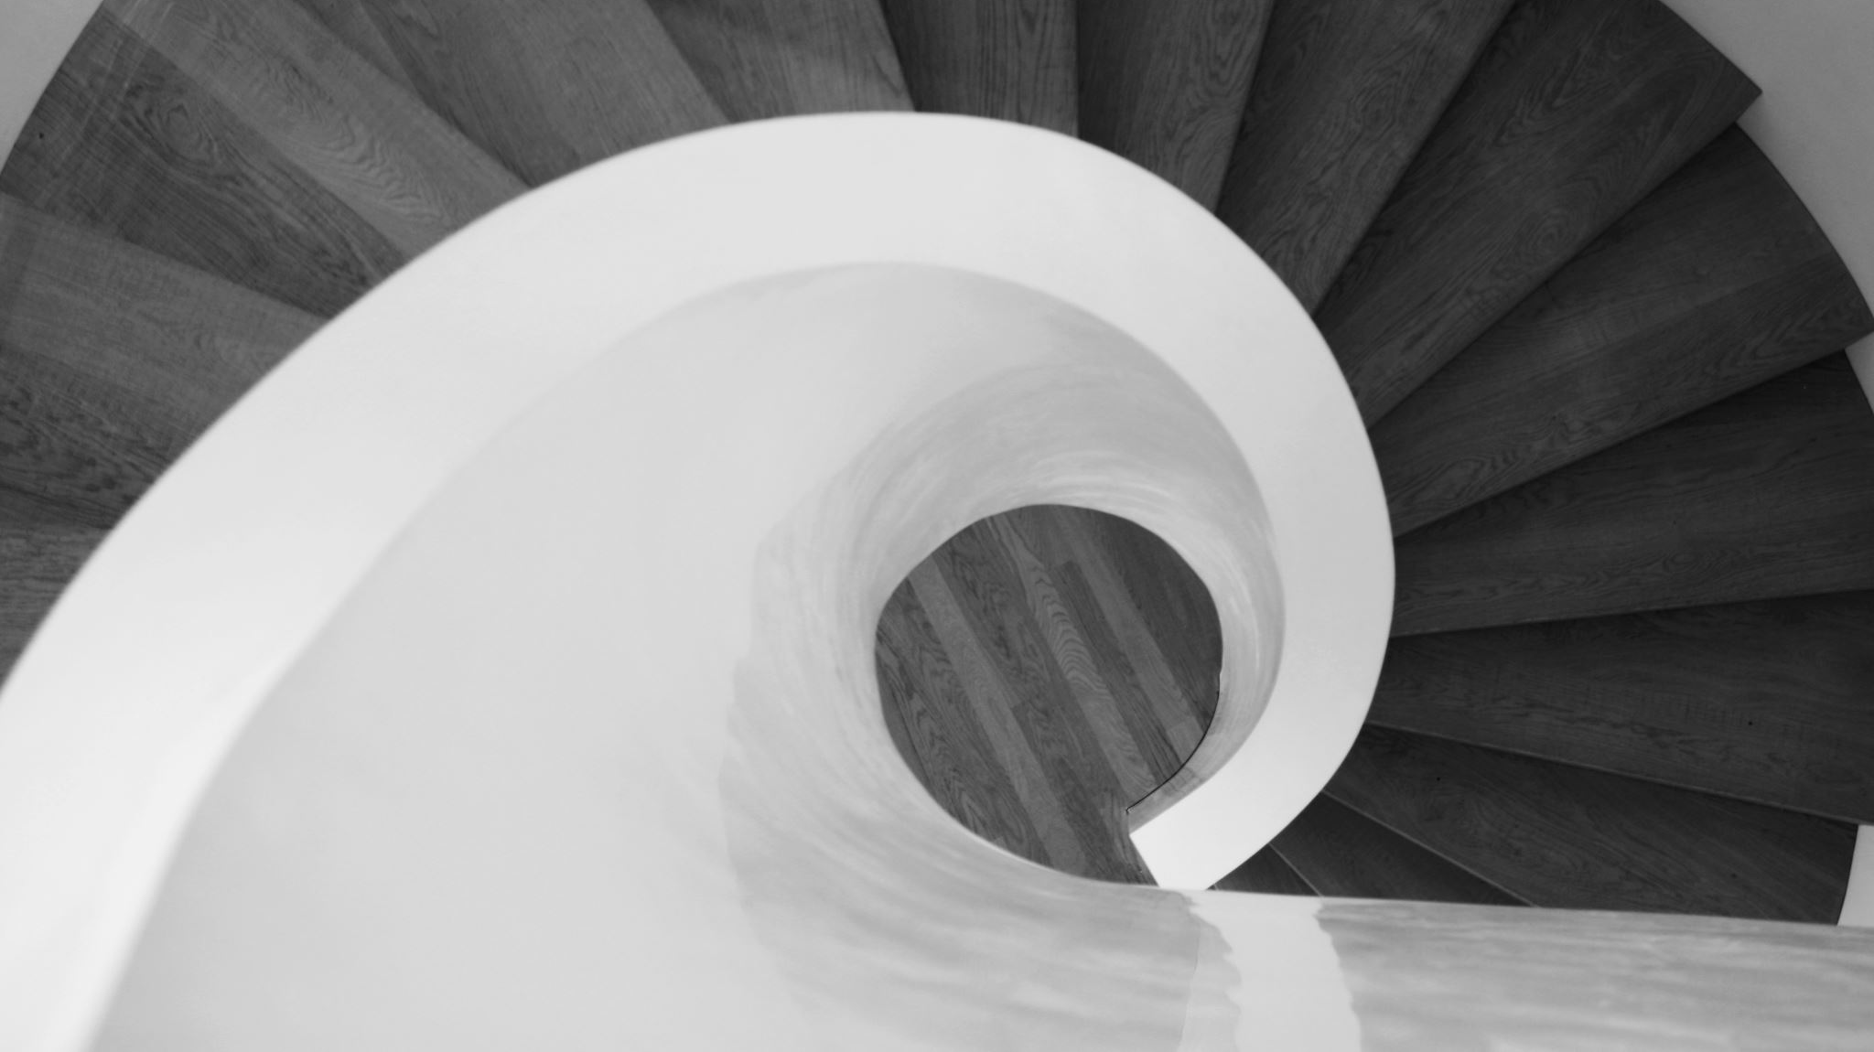
Ethical alternatives
Also known as: Don’t be a 🍆

Slide 46

Lawmakers have noticed dark patterns
* Amazon to pay FTC historic $2.5 billion settlement for allegedly tricking customers into signing up for Prime | CNN Business
* 2019: UK’s CMA has enacted new laws around booking sites
* 2021: the Federal Trade Commission (FTC) put out an enforcement policy statement, which warned businesses against using dark patterns to trap or trick consumers into subscription services.
* Dark Pattern lawsuits in the USA (four states)
* LinkedIn settled for $13 Million for dark pattern usage (friend SPAM)
2023: Germany & EU Target Dark Patterns in Apps
More lawsuits are happening in more countries every day…
Notes:
Competition and Markets Authority
German Authority and EU Bodies Target "Dark Patterns" in Trading Apps and Online Interfaces | Perspectives & Events | Mayer Brown

Slide 47
Ethical alternatives
Is this design illegal?
  Better call Saul! (don’t. this is bad advice)
Does this really consider the customer’s needs and wants?
If I were the customer, how would I feel?
  Dogfood your product.
Could this design pattern damage my reputation (or a client’s)?
Pro tip: If you end up in a talk like this, you’re doing it wrong.

Slide 48
Dark Pattern Audit
Have an actual UX team or role
Have an actual QA team or role
Have a formal ethics committee
Collect data from focus groups
Keep up with research
Dogfood your software

Slide 49
Resources
https://www.deceptive.design/
https://growth.design/psychology
https://growth.design/case-studies

Slide 50
More Resources
Paul Boag’s talk, featuring how dark patterns hurts you in the long run
90% of Everything - Dark Patterns and Dirty Tricks
Stop calling these Dark Design Patterns or Dark UX — these are simply a**hole designs | by Flavio Lamenza | UX Collective (uxdesign.cc)
How to fight the 'dark patterns' websites deploy to trick you to spend more - ABC News
Dark Patterns and the Ethics of Design | by UIE | Adventures in UX Design | Medium

Slide 51
Thank you!
https://bsky.app/profile/rachelappel.bsky.social
https://www.linkedin.com/in/rachelappel/

